Slide 1
Solarwind Modelica model
Filip Jorissen
Lieve Helsen

Slide 2
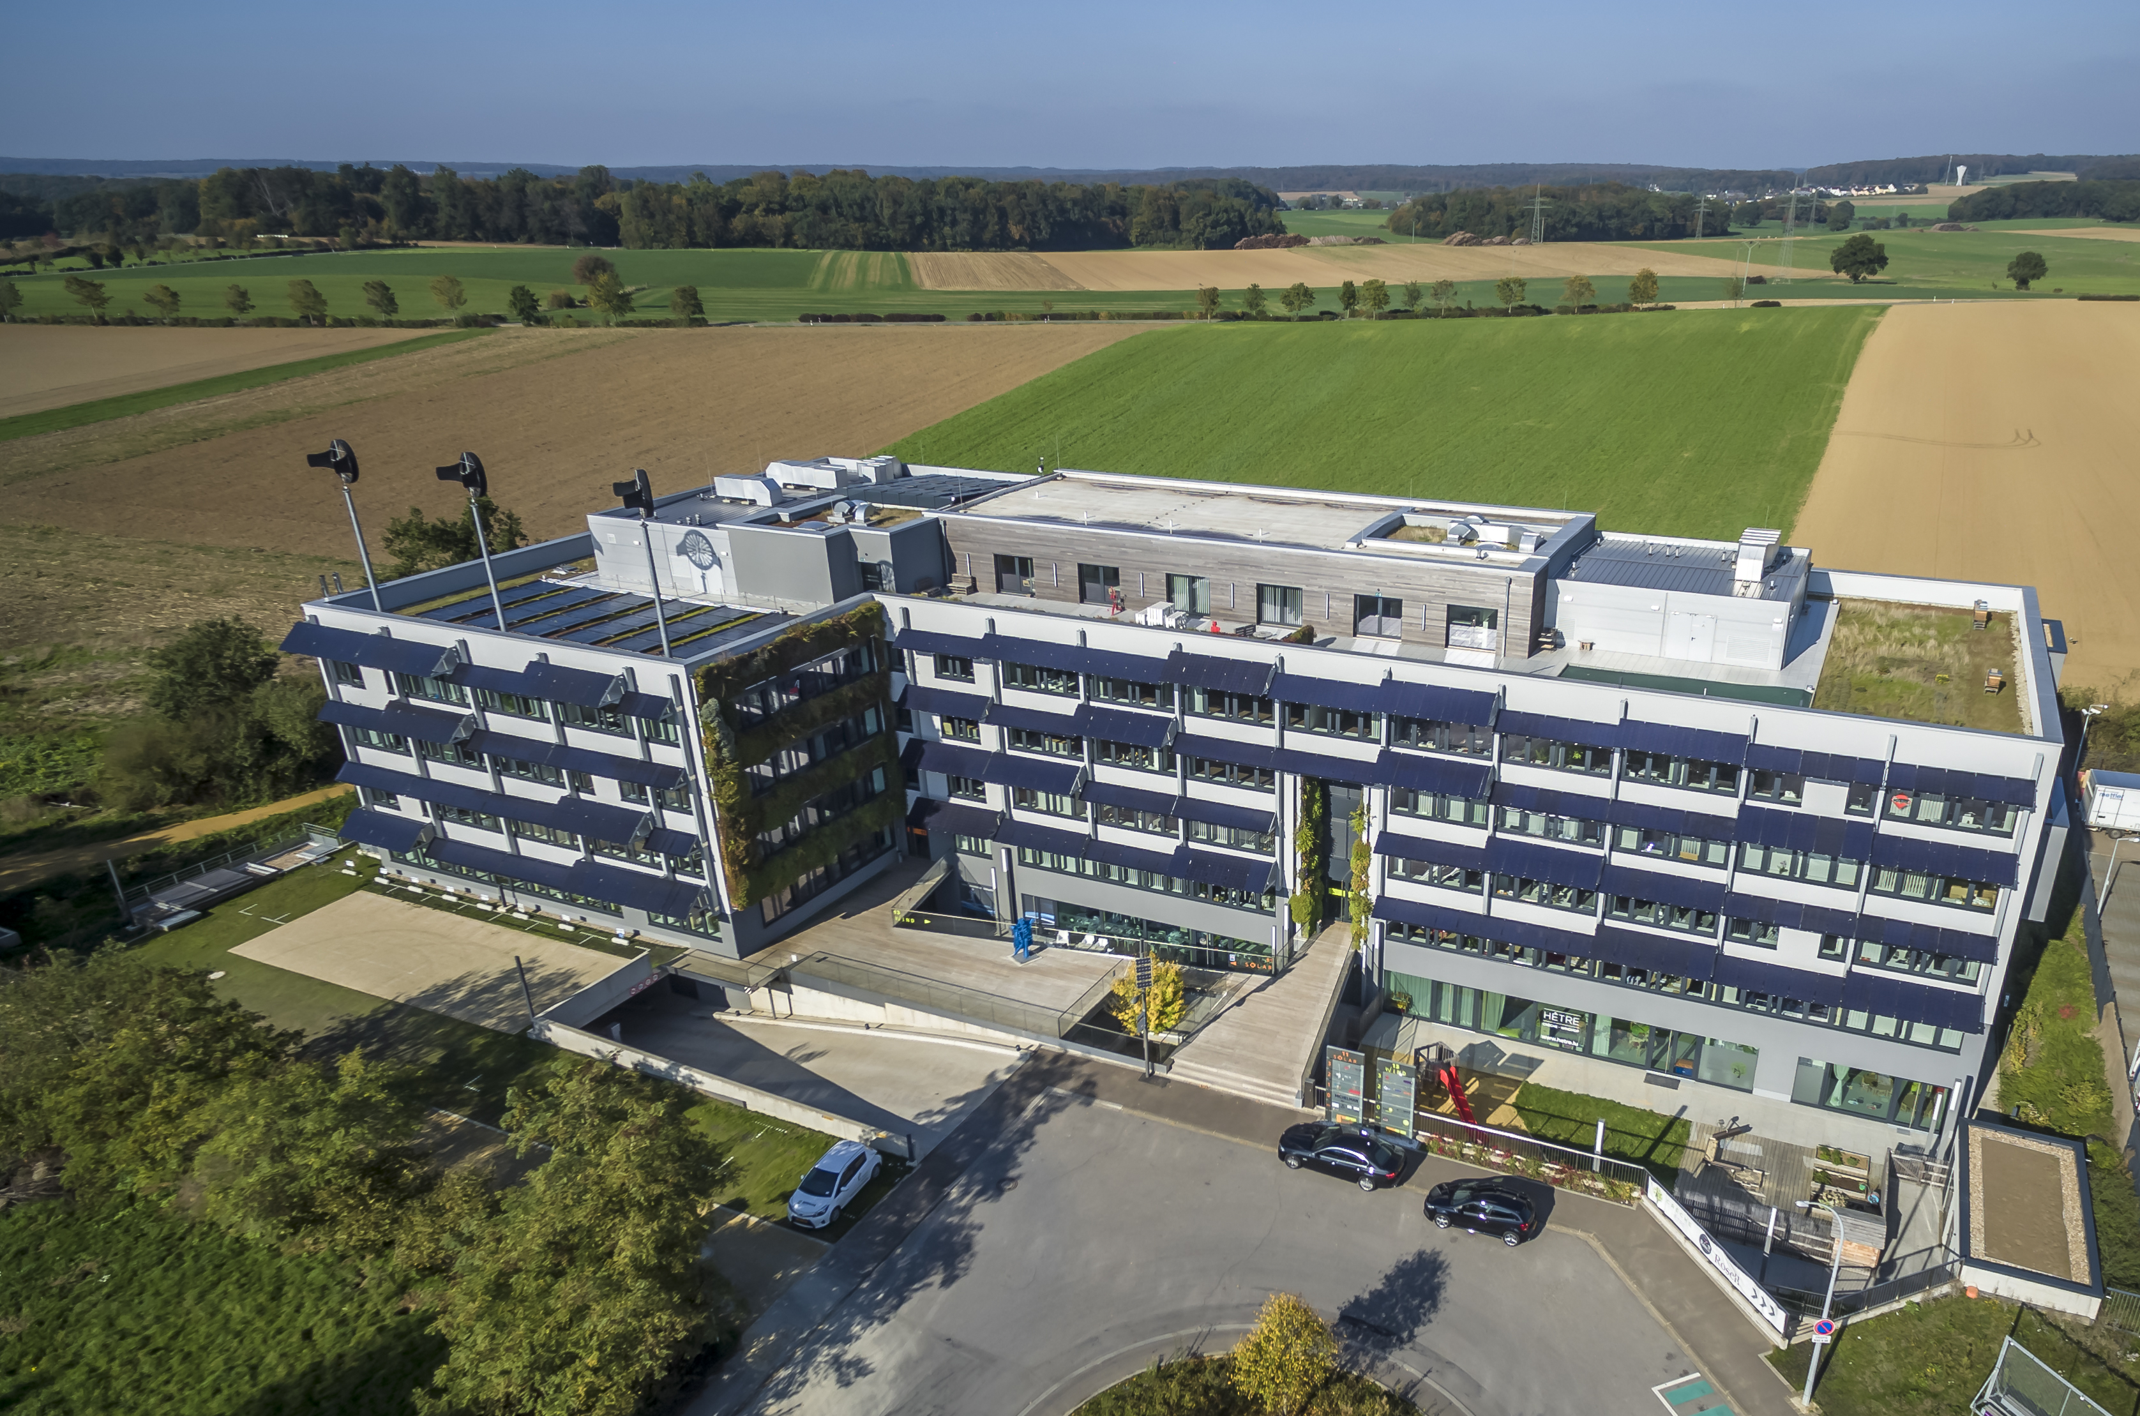
Introduction to Solarwind
Courtesy of Progroup

Slide 3
Key facts
Demonstration building of sustainability
Office building ~ 10 000 m²
Six floors of which four are modelled
HVAC: 4 x HP, TES (20 m³), CCA, borefield, AHU, 60 m² solar collectors, pellet furnace, PV, etc.
Facade: light wall, U value of 0.8 W/m²K, triple glazing
Rule based control implementation

Slide 4
Model implementation
32 zones using IDEAS
Individually controlled CCA and VAV for each zone
Pressure-driven air flow model and hydronic model
HVAC implemented using IDEAS, IBPSA, Buildings
Validated using on-site measurement data
HVAC up to high accuracy
Heat balance of the model shows large differences

